Slide 1

GamersHub: A Games Hub
Dhananjay Agarwal – 23107121
Project Guide
Ms. Sarala M

Slide 2
Contents
Introduction
Objectives
Scope
Features / Functionality
Project Outcomes
Technology Stack
Block Diagram if applicable

Slide 3
1. Introduction
Problem Identified:-
Complex Game Management: Users often face difficulties in managing multiple games, leading to confusion and inefficient use of time.
User Engagement Challenges: Traditional game interfaces may lack engaging features, resulting in reduced user interaction and satisfaction.
Solution Proposed:-
Centralized Game Launcher: The application provides a desktop interface that serves as a central hub for launching and managing multiple games, ensuring streamlined access and organization.
Enhanced User Experience: The platform includes a visually appealing dark theme and intuitive navigation, improving user engagement and satisfaction through a seamless gaming experience.

Slide 4
2. Objectives
Develop a user-friendly game launcher interface.
Integrate multiple games into a single application.
Provide a seamless user experience with a consistent theme and design.
Ensure easy navigation and game selection.

Slide 5
3. Scope
Non-Profit Organizations (NPOs) and Charities: This is the most direct and obvious application. NPOs and charities can use CrowdNest to manage donations of goods, connect with local recipients, and streamline their resource distribution efforts.
Community Centers and Local Municipalities: Community centers and local governments can utilize CrowdNest to facilitate resource sharing among residents, promote community engagement, and address local needs.
Educational Institutions (Schools, Colleges, Universities): Schools and colleges can use CrowdNest to facilitate the exchange of resources among students and staff, promote sustainability, and support students in need.
Corporate Social Responsibility (CSR) Initiatives: Description: Companies can integrate CrowdNest into their CSR programs to facilitate employee-driven donation initiatives, support local communities, and promote sustainability.
Residential Communities (Apartment Complexes, Neighborhood Associations): Homeowner or apartment complexes can leverage CrowdNest to coordinate local donations and exchanges.

Slide 6
4. Feature /Functionality
Dark Theme Interface: A visually appealing dark theme with customizable styles.
Game Selection: Buttons to launch different games.
User Authentication: Integration with a database for user login and data management.
Window Management: Automatic window handling for launching and closing games.

Slide 7
5. Outcome of Project
A fully functional game launcher application.
Integration of at least two games with the ability to add more in the future.
A consistent and attractive user interface.

Slide 8
6. Technology Stack
Programming Language
Python : The core programming language used for developing the application.
GUI Framework
Tkinter : Tkinter is used to build the desktop application's user interface, providing components like buttons, labels, and entry fields.
Database
MySQL: A relational database management system used for persistent storage of user data, donation records, and request tracking.
Additional Libraries
ttk (Themed Tk) : Part of the Tkinter library, used for creating themed widgets that provide a modern look and feel to the application interface.

Slide 9
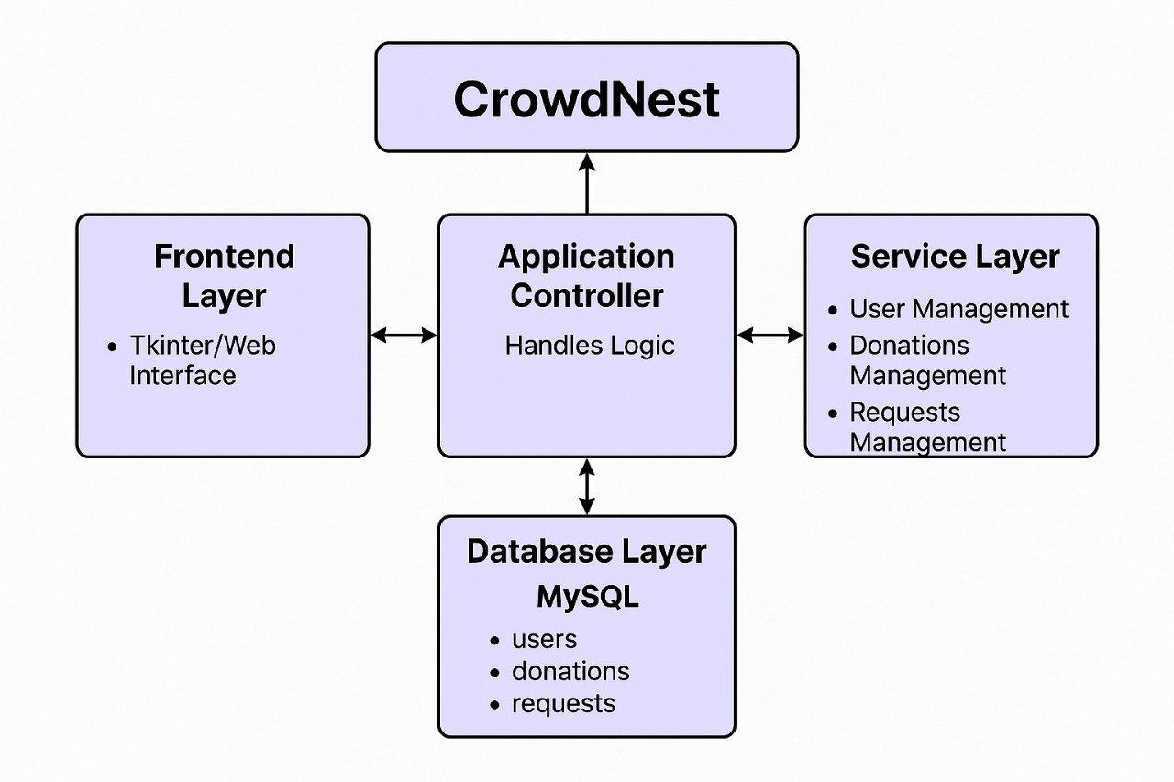
7. Block Diagram

Slide 10
Thank You...!!

